Slide 1
Boreal forest (taiga)
Ella k

Slide 2
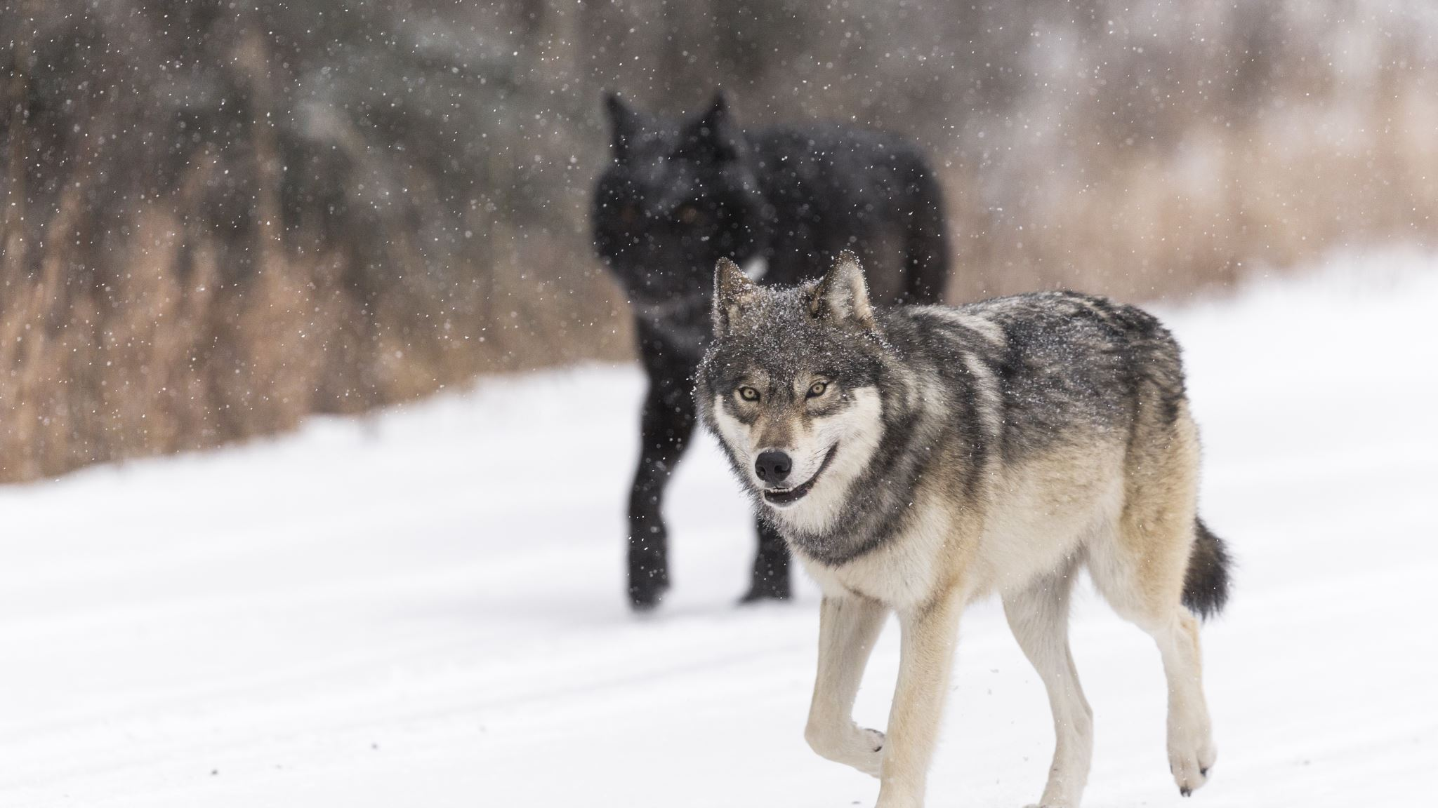
The animals in the taiga
snowshoe hares, otters, ermines, squirrels and moles are just some in a range of over 300 different species of animals.

Slide 3
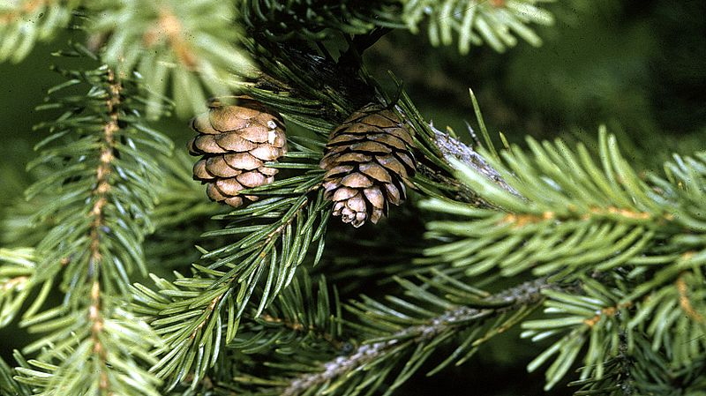
Plants in the taiga
There are birch and poplar but mostly it is dominated by conifer species.
This Photo by Unknown author is licensed under CC BY-SA.

Slide 4
Three abiotic factors of a taiga
Rocks
Soil
Water

Slide 5
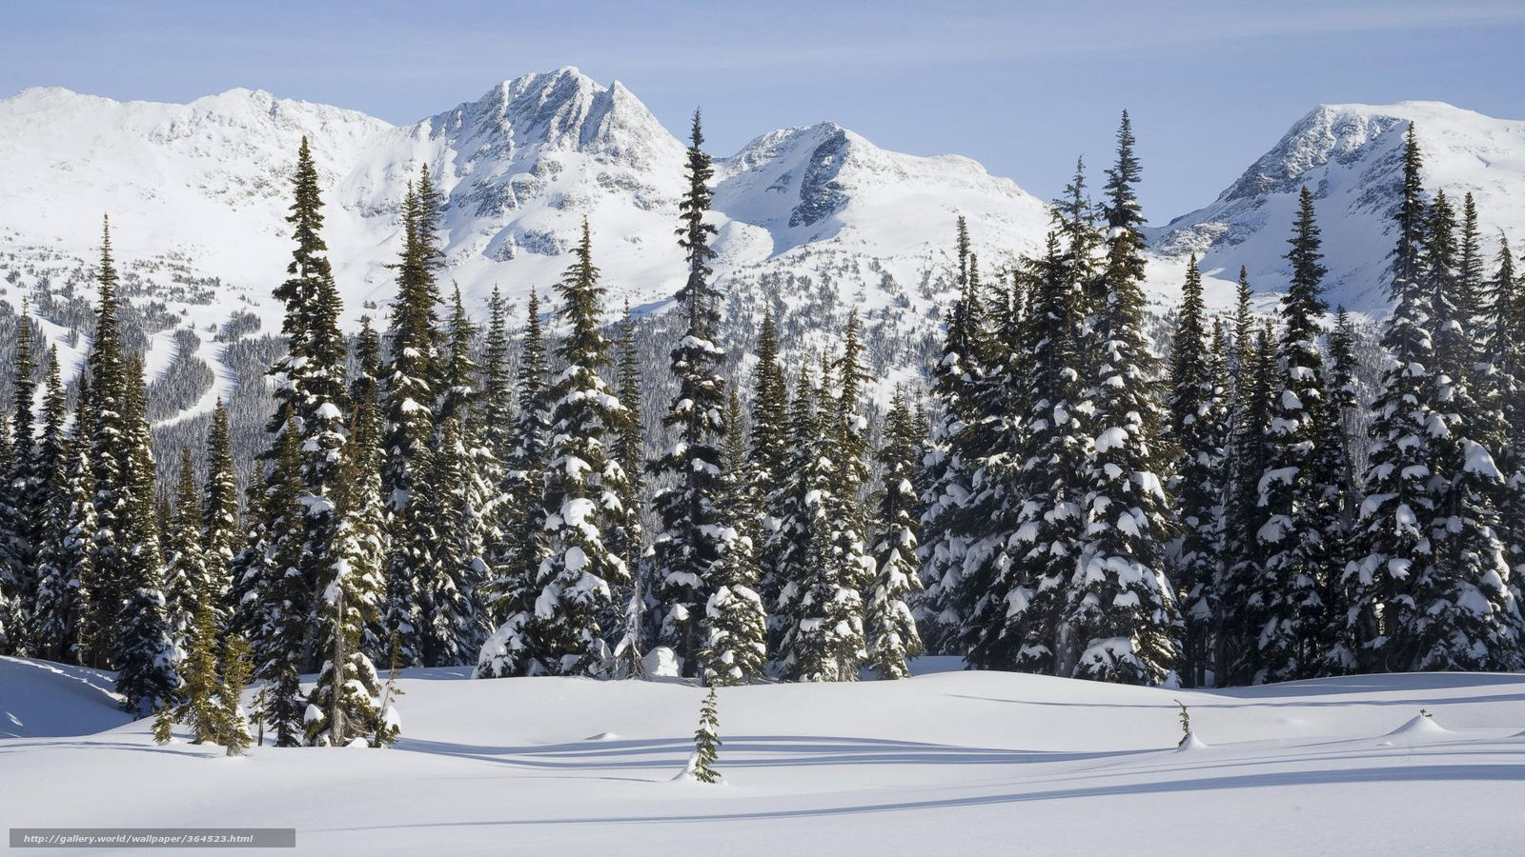
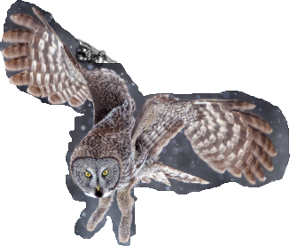
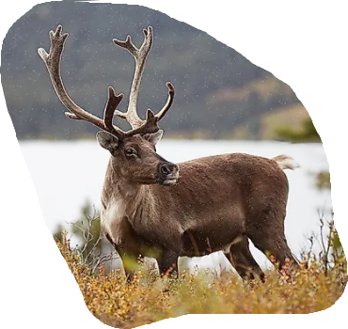
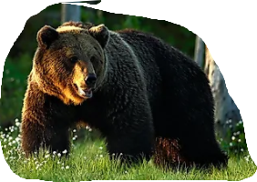
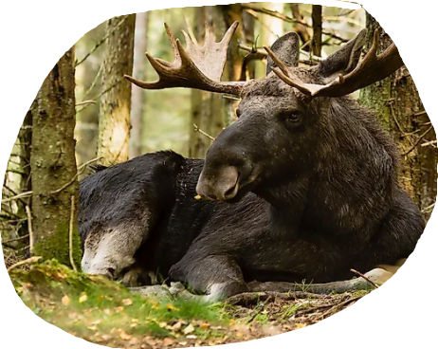
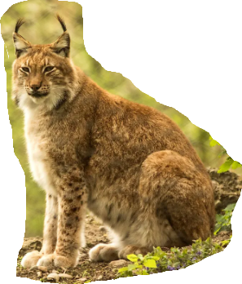
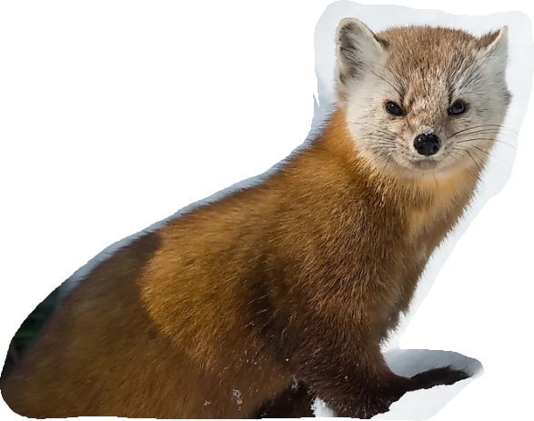
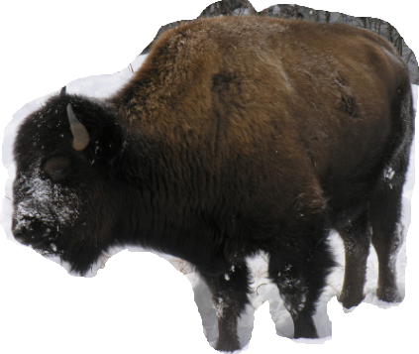
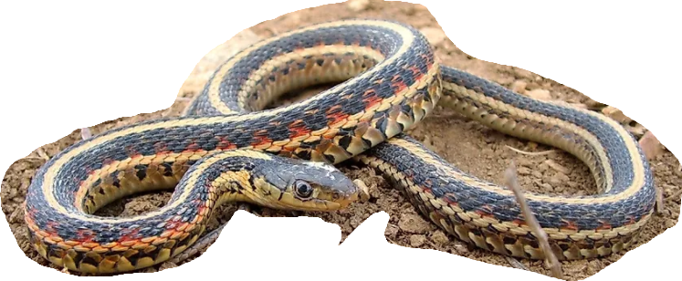
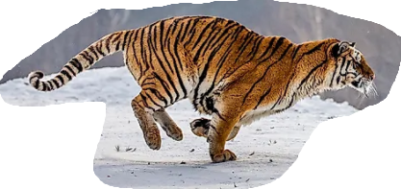
Great grey owl
moose
Brown bear
Caribou
Lynx
American Marten
Siberian Tiger
Red sided Garder snake
Wood bison

